Slide 1
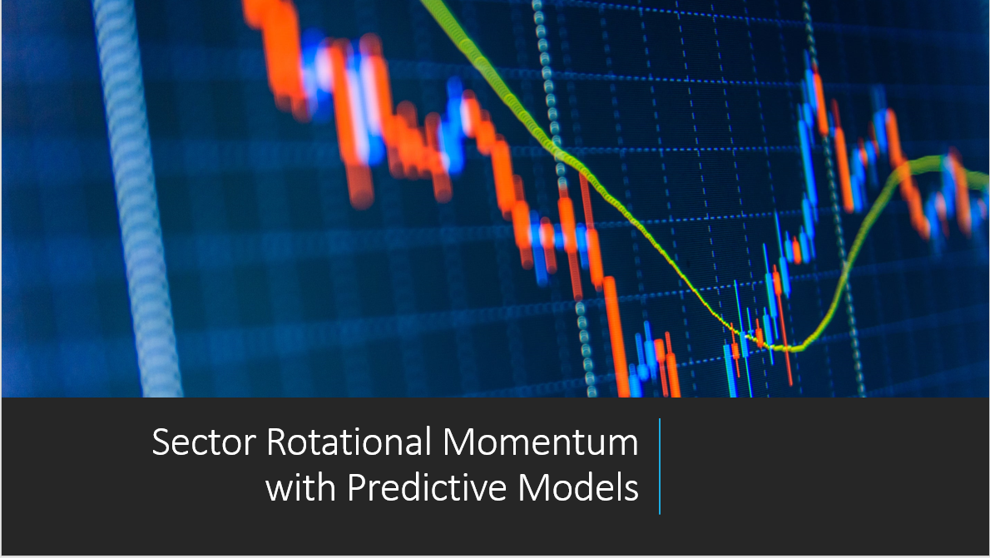

Slide 2
AGENDA
1. INTRODUCTION
2. LITERATURE REVIEW
3. CONCEPT REVIEW
4. ALGORITHM OVERVIEW
5. RESULTS
6. NEXT STEPS
Notes:
We gathered this Credit Committee as we received a call from Element Fleet management CFO to increase our existing senior credit facility in 500M.
So give an overview of the transaction it would be a syndicated facility with at least 5 banks participating and a maximum hold of 20% for TD.
The company is Element Fleet the leading fleet management company in US and Canada, offering leasing financing and fleet services to its clients.
We believe that the company faced some challenges in the past specifically to its funding and execution on previous M&A deals, but we also believe that the company has a positive outlook going forward as they recently replaced their management team and are implementing future initiatives that will bring 150M in operating income to them. Other than initiatives like dividens reduction and and dividends re-investments that shall help them to achieve a stable operating income for the next few years.
As we can see from this stable we are expecting an overall stable revenues and net income for the company with the expection of 2018 were we already know that the company will be impacted by one off non-cash expense related to 19th capital non core investments.
Also in terms of leverage we expect stable level going forward with enough core assets coverage for the companys debt.
Finally, we belive we should move forward with the transaction as it will generate 6M in revenues for the bank, this is an investment grade company both by our internal model and the market credit agencies and we believe that approving this deal, might bring even further businesses to the bank and we will discuss later

Slide 3
INTRODUCTION
Rotational Momentum Strategy (General Concept)
This basic principle ensures that investors are out of the market during extended downtrends and in the market during extended uptrends, utilizing momentum.
Sectors ETFs are invested in for a specific optimized holding period to take advantage of the momentum phenomenon
An optimized lookback period and frequency of trading must also be determined using a training and testing data set.
After each prescribed holding period, the portfolio is rebalanced based on the sector ETFs with the best performance in terms of momentum.
Essentially, the investment is rotated between the sector ETFs displaying the strongest performance.
This rotation strategy can be applied to sub classes of assets (such as ETFs) or multi class assets as well. For the purpose of this course, we shall focus on the ETF class of securities.

Slide 4
INTRODUCTION
Rotational Momentum Strategy (General Concept)
Day 1
Day 2
Day 3
HP1
Day 6
HP2
1
1
1
1
2
2
2
2
Top “n” ETFs Are
Chosen for Investment
Top “n” ETFs Are
Chosen for Investment
3
3
3
3
1
2
3
1
2
3
4
4
4
4
Investment is Held in
These ETFs Until the Next
Holding Period
Investment is Held in
These ETFs Until the Next
Holding Period
5
5
5
5
6
6
6
6
Time

Slide 5
LITERATURE REVIEW
Profitable Momentum Trading Strategies for Individuals - Foltice & Langer (2015)
Momentum investing strategies have been executed successfully for many years by experienced traders. Foltice & Langer (2015) wrote a paper on implementing a practical strategy for individual investors with limited access to capital, smaller portfolio of stocks with a long-only constraint.
Momentum Strategies for the ETF-Based Portfolios - Nadler & Schmidt (2019)
Nadler & Schmidt (2019) demonstrate that the conventional momentum pattern may not be universal.
White Paper: Relative Strength Strategies for Investing - Faber and O'Shaunessey (2010)
Faber and O'Shaunessey (2010) sought to evaluate the effectiveness of a rotational momentum strategy. Using sector/industry group data going back to the 1920s, Faber found that a simple momentum strategy outperformed the buy-and-hold strategy approximately 70% of the time.

Slide 6
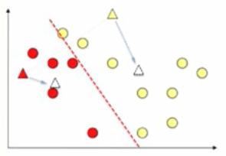
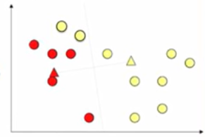
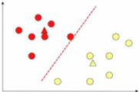
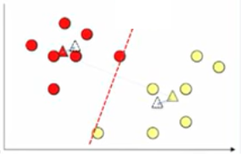
CONCEPT REVIEW
K-Mean Clustering
Example
Popular for cluster analysis in data mining.
Input: k, {x₁ …… x_{n}}
Partition n observations into k clusters in which each observation belongs to the cluster.
Algorithm:
Place centroids {c₁ …… c_{k}} at random location.
Repeat until convergence:
For each point x_{i} point:
Find the nearest c_{j}.
Assign to x_{i} nearest c_{j}.
For each cluster j = 1 ……. K:
New centroid is the mean of all x’s in the cluster.
Convergence occurs when x’s stop changing clusters and there will be k total clusters.
1
2
3
4
Notes:
We gathered this Credit Committee as we received a call from Element Fleet management CFO to increase our existing senior credit facility in 500M.
So give an overview of the transaction it would be a syndicated facility with at least 5 banks participating and a maximum hold of 20% for TD.
The company is Element Fleet the leading fleet management company in US and Canada, offering leasing financing and fleet services to its clients.
We believe that the company faced some challenges in the past specifically to its funding and execution on previous M&A deals, but we also believe that the company has a positive outlook going forward as they recently replaced their management team and are implementing future initiatives that will bring 150M in operating income to them. Other than initiatives like dividens reduction and and dividends re-investments that shall help them to achieve a stable operating income for the next few years.
As we can see from this stable we are expecting an overall stable revenues and net income for the company with the expection of 2018 were we already know that the company will be impacted by one off non-cash expense related to 19th capital non core investments.
Also in terms of leverage we expect stable level going forward with enough core assets coverage for the companys debt.
Finally, we belive we should move forward with the transaction as it will generate 6M in revenues for the bank, this is an investment grade company both by our internal model and the market credit agencies and we believe that approving this deal, might bring even further businesses to the bank and we will discuss later

Slide 7
CONCEPT REVIEW
Parameters
Algorithm compares ETFs to different moving averages in the calculation of the total score:
Aperiod
Originally, a short-term moving average (rolling average or running average)
Bperiod
Originally, a long-term moving average (rolling average or running average)
Speriod
A period for which volatility is calculated for each ETF
Frequency
Holding Period. How long are you holding the ETF before trading.
“W” = Every week; “2W” = Every 2 Weeks. etc...
“W-TUE” = Every Tues; “2W-TUE” Every 2 Tues, etc…
20W – Predicted Return
Returns for each ETF is lagged by 20 Weeks and a sperate prediction algorithm trained for each ETF to predict the 20W return.
In total 19 prediction models were created for each run
ETF Diversification
The top reason for choosing an ETF over stock is instant diversification
Market ETFS, Sector ETFs, Currency ETFs, Commodity ETFS
Portfolio of ETFs provides further direction and reduces volatility
Diversification amongst different classes
Diversification amongst different markets
Diversification amongst different sectors
Notes:
We gathered this Credit Committee as we received a call from Element Fleet management CFO to increase our existing senior credit facility in 500M.
So give an overview of the transaction it would be a syndicated facility with at least 5 banks participating and a maximum hold of 20% for TD.
The company is Element Fleet the leading fleet management company in US and Canada, offering leasing financing and fleet services to its clients.
We believe that the company faced some challenges in the past specifically to its funding and execution on previous M&A deals, but we also believe that the company has a positive outlook going forward as they recently replaced their management team and are implementing future initiatives that will bring 150M in operating income to them. Other than initiatives like dividens reduction and and dividends re-investments that shall help them to achieve a stable operating income for the next few years.
As we can see from this stable we are expecting an overall stable revenues and net income for the company with the expection of 2018 were we already know that the company will be impacted by one off non-cash expense related to 19th capital non core investments.
Also in terms of leverage we expect stable level going forward with enough core assets coverage for the companys debt.
Finally, we belive we should move forward with the transaction as it will generate 6M in revenues for the bank, this is an investment grade company both by our internal model and the market credit agencies and we believe that approving this deal, might bring even further businesses to the bank and we will discuss later

Slide 8
CONCEPT REVIEW
Rotational Momentum Strategy (General Concept)
Parameters
Day 1
Day 2
Day 3
HP1
Selection is made on the weighted rank of each ETF based on the following scores:
A_Rank = Aperiod Momentum
B_Rank = Bperiod Momentum
S_Rank = Speriod Volatility
RF_Rank/SVC_Rank = Predicted Return from ML Algorithm
Equal weight of 30% is given per ranking factor (A_Rank, B_Rank, S_Rank) and a negative is applied for RF_Rank/SVC_Rank (negative score as the list is ordered 1-19 with the lowest score representing the highest rank)
1
1
1
2
2
2
Top “n” ETFs Are
Chosen for Investment
3
3
3
1
2
3
4
4
4
Investment is Held in
These ETFs Until the Next
Holding Period
5
5
5
6
6
6
Time
8
Notes:
We gathered this Credit Committee as we received a call from Element Fleet management CFO to increase our existing senior credit facility in 500M.
So give an overview of the transaction it would be a syndicated facility with at least 5 banks participating and a maximum hold of 20% for TD.
The company is Element Fleet the leading fleet management company in US and Canada, offering leasing financing and fleet services to its clients.
We believe that the company faced some challenges in the past specifically to its funding and execution on previous M&A deals, but we also believe that the company has a positive outlook going forward as they recently replaced their management team and are implementing future initiatives that will bring 150M in operating income to them. Other than initiatives like dividens reduction and and dividends re-investments that shall help them to achieve a stable operating income for the next few years.
As we can see from this stable we are expecting an overall stable revenues and net income for the company with the expection of 2018 were we already know that the company will be impacted by one off non-cash expense related to 19th capital non core investments.
Also in terms of leverage we expect stable level going forward with enough core assets coverage for the companys debt.
Finally, we belive we should move forward with the transaction as it will generate 6M in revenues for the bank, this is an investment grade company both by our internal model and the market credit agencies and we believe that approving this deal, might bring even further businesses to the bank and we will discuss later

Slide 9
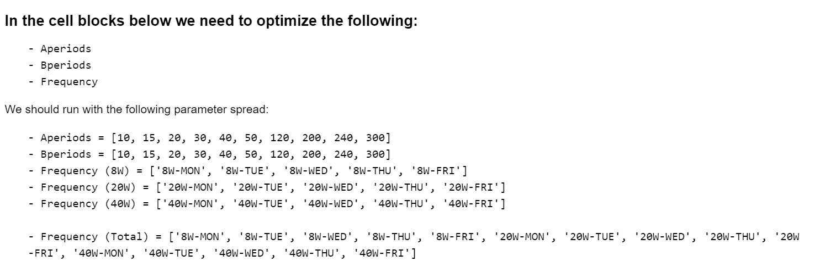
Motivation – Past Studies

Slide 10
Motivation – Past Studies
Top 10 Annual Return Combinations from Training Data
TotaAnnReturn | CAGR | Sharpe Ratio | Aperiods | Bperiods | Frequency
36.11 | 26.75 | 1.52 | 15 | 20 | 20W-FRI
35.25 | 26.24 | 1.42 | 20 | 15 | 20W-MON
34.90 | 26.03 | 1.42 | 15 | 20 | 20W-MON
34.75 | 25.94 | 1.41 | 15 | 15 | 20W-MON
34.40 | 25.74 | 1.62 | 40 | 20 | 20W-FRI
34.00 | 25.50 | 1.73 | 20 | 20 | 20W-FRI
33.17 | 24.99 | 1.68 | 10 | 20 | 20W-FRI
33.17 | 24.99 | 1.68 | 20 | 10 | 20W-FRI
32.65 | 24.68 | 1.60 | 30 | 20 | 20W-FRI
32.16 | 24.38 | 1.35 | 15 | 30 | 20W-FRI
32.16 | 24.38 | 1.35 | 30 | 15 | 20W-MON

Slide 11
Motivation – Past Studies
Top 10 Total Annual Return Results on Test Data from Top Performing Training Set Combinations
TotaAnnReturn | CAGR | Sharpe Ratio | Aperiods | Bperiods | Frequency
10.18 | 9.41 | 0.85 | 50 | 15 | 20W-TUE
9.122 | 8.48 | 0.75 | 15 | 50 | 20W-MON
8.568 | 8.00 | 0.71 | 15 | 50 | 20W-FRI
7.86 | 7.35 | 0.63 | 50 | 15 | 20W-THU
7.41 | 6.94 | 0.69 | 20 | 30 | 20W-MON
7.07 | 6.63 | 0.68 | 20 | 20 | 20W-THU
6.83 | 6.41 | 0.63 | 30 | 15 | 20W-THU
6.68 | 6.28 | 0.58 | 15 | 30 | 20W-FRI
6.45 | 6.07 | 0.61 | 10 | 50 | 20W-THU
6.23 | 5.87 | 0.60 | 15 | 30 | 20W-MON
6.04 | 5.69 | 0.58 | 50 | 20 | 20W-TUE

Slide 12
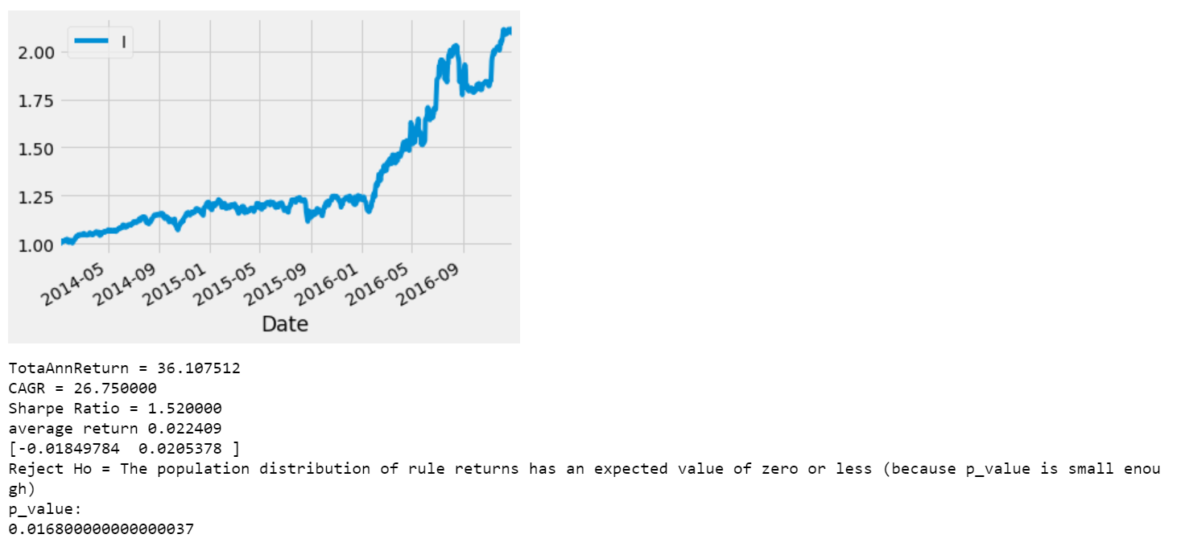
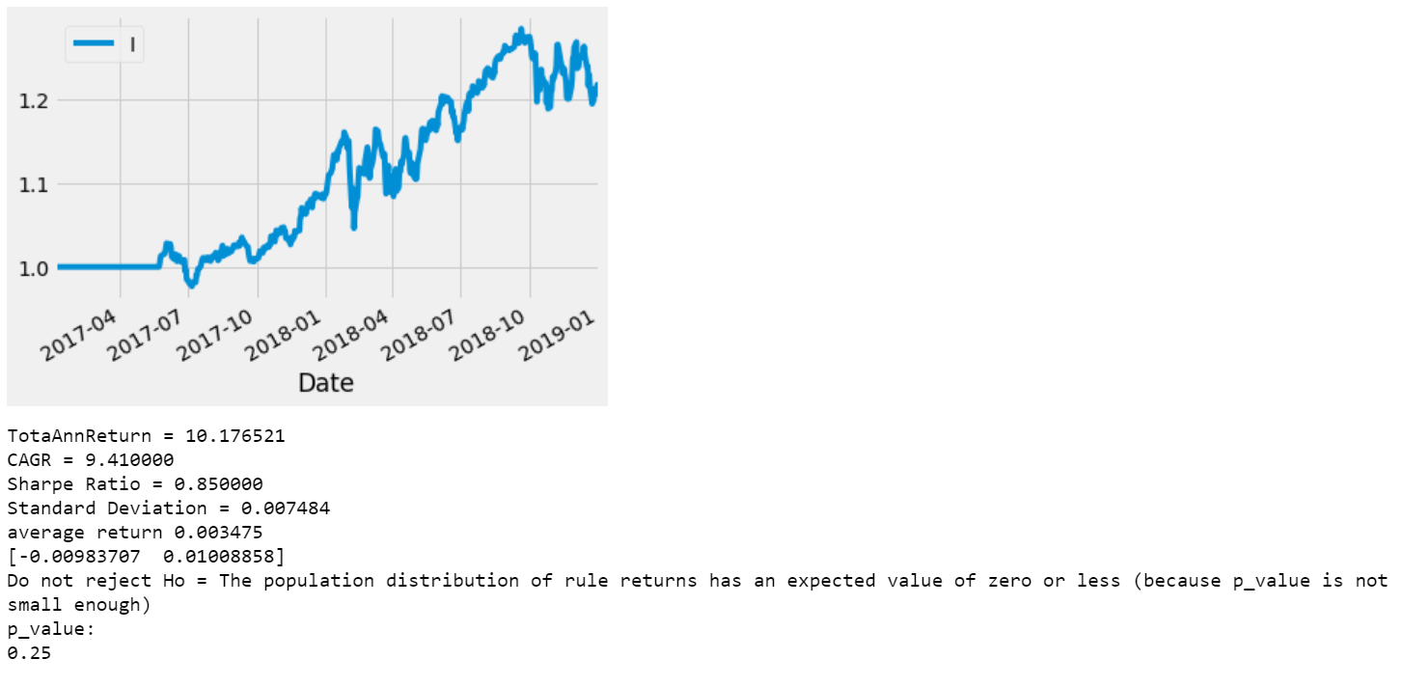
Motivation – Past Studies
Training Data (Best TotaAnnReturn)
Testing Data (Best TotaAnnReturn)
Fix Holding Period as 20W-THU
Solely Momentum based decisions work for the beginning of holding periods, but when holding period is long (20 Weeks) being stuck in a position has significant detrimental effects
Options:
Risk Management (200 MA Pullout)
Incorporate Predictive Returns for ETFs across holding period in evaluation of which ETF to select each holding period

Slide 13
ALGORITHM OVERVIEW
Sector-based Rotational Momentum strategy
Eighteen industrial sector ETF that represent a broad range of stocks in the US market were chosen as the group of securities to execute the rotational momentum strategy.
Industries Include:
Independent Power and Renewable Electricity Producers
Health Care Technology
Road and Rail
Building Products
Containers and Packaging
Construction Materials
Energy Equipment and Services
Professional Services
Machinery
Life Sciences Tools and Services
Electrical Equipment
Biotechnology
Oil, Gas and Consumable Fuels
Air Freight and Logistics
Media
Interactive Media and Services
Diversified Consumer Services
Distributors
Real Estate Management and Development
Electronic Equipment, Instruments and Components
Trading Companies and Distributors
Health Care Equipment and Supplies
IT Services
Metals and Mining
Capital Markets
Insurance
Industrial Conglomerates
Hotels, Restaurants and Leisure
Diversified Telecommunication Services
Personal Products
Chemicals
Gas Utilities
Multi-Utilities
Textiles, Apparel and Luxury Goods
Aerospace and Defense
Speciality Retail
Diversified Financial Services
Airlines
Construction and Engineering
Automobiles
Electric Utilities
Semiconductors and Semiconductor Equipment
Household Durables
Equity Real Estate Investment Trusts
Software
Commercial Services and Supplies
Food and Staples Retailing
Beverage
Entertainment
Multiline Retail
Tobacco
Household Products
Heath Care Providers and Services
Leisure Products
Internet and Direct Marketing Retail
Pharmaceuticals
Auto Components
Technology Hardware, Storage and Peripherals
Communications Equipment
Marine
Mortgage REITs
Paper and Forest Products
Thrifts and Mortgage Finance
Transportation Infrastructure

Slide 14
ALGORITHM OVERVIEW
Modifications to the Sector-based Rotational Momentum strategy
1) Training-Testing Data
ETF daily closing prices from 2014 – 2017 were selected as the training set, and data from 2017 to 2019 was selected as the testing set.
2) Clustering algorithm to categorize ETFs
ETFs with similar volatility reduced the overall bias in the portfolio and provided assurance that specific low-volatility ETFs were not dominating the portfolio consistently.
3) Optimization on Aperiods, Bperiods, and Speriods
The Sector-Based Rotational Momentum program was optimized on 288 combinations of Aperiods, Bperiods, and Speriods (Ie. 288 trading models were constructed).
The Frequency was held at 20W-THU based on past results
3) Addition of Predictive Modelling for 20W Returns
20W Returns were lagged in a training set consisting of 2010-2017 Returns
19 Separate Models using RF Regression, RF Classification, and SVM Regression were trained to predict returns on a test set from 2017-2019
Predictions for returns were ranked for each ETF and added as a sperate evaluation component in the determination of which ETF to select at the end of a holding period

Slide 15
RESULTS
K-Means Clustering
K-Means - 3 Clusters
Cluster 1 | Cluster 2 | Cluster 3
XLU | XLV | DIA
GDX | XLE | IHI
XLF | XLY | IYW
XLK | VNQ
XLP | RXI
XRT | VIS
KBE | SIL
FXU
SHY
K-Means - 5 Clusters
Cluster 1 | Cluster 2 | Cluster 3 | Cluster 4 | Cluster 5
XLF | DIA | XLV | XLU | SIL
FXU | IHI | XLE | GDX
SHY | IYW | XLY | XLK
 |  | VNQ | XLP
 |  | RXI | XRT
 |  | VIS | KBE

Slide 16
MACHINE LEARNING MODELS FOR ETF PRICE PREDICTION
Data retrieval, feature engineering, data preparation
1) Price, share volume, closing bid, closing ask, holding period return, market return, SHROUT data for each chosen ETF downloaded from CRSP vendor through WRDS
2) Calculated various features of each ETF
1, 3, 12 month returns
Volatility
Standard deviation of the returns and the market
Covariance with the market
12 month Beta
Idiosyncratic volatility
3) Prepared data for the ML models
Data cleaning
Train-test split by specified row index
For classification models, the target price was converted into a 0, 1, or 2 label depending on if the return was below the lower bound, between the upper and lower bounds, or above the upper bound
Upper bound = 33rd percentile, lower bound = 66th percentile, ignoring NaNs
Notes:
#Select the following attributes:
#Price, PRC
#Share Volume, VOL
#Closing Bid, BID
#CLosing Ask, ASK
#Holding Period Return, RET
#Return on S&P Composite Index, sprtrn
#Number of Shares Outstanding, SHROUT

Slide 17
MACHINE LEARNING MODELS FOR ETF PRICE PREDICTION
Machine Learning Model Outline
1) Define type of machine learning model:
Regression
Classification
Both types were performed for each algorithm
2) Defined the ML pipeline:
Standard Scaler (rf), MinMaxScaler (svm/gb)
SelectFromModel - feature selection based on feature importance threshold
ML model
3) Select desired hyperparameters to build a parameter grid:
random forest: n_estimators, max_features, max_depth, threshold
support vector machine: kernel, C, gamma, degree
gradient boosting: loss function, n_estimators, max_depth, alpha
4) Performed 5 fold cross validation on the parameter grid with to try and reduce overfitting
5) Fit optimized model to the training set and make predictions on the test set
Notes:
threshold: the threshold value for feature importance values
Found that the model was overfitting a lot when only optimizing with the n_estimators hyperparameter

Slide 18
MACHINE LEARNING MODELS FOR ETF PRICE PREDICTION
Random Forest Model Results
Random Forest Regression
 | error | testr2 | trainr2
FXU | 0.0061 | -0.497 | 0.669
GDX | 0.0278 | -4.275 | 0.884
KBE | 0.0112 | -0.288 | 0.566
RXI | 0.0054 | -0.286 | 0.726
VNQ | 0.0061 | -0.460 | 0.727
XLP | 0.0055 | -0.457 | 0.707
XRT | 0.0086 | 0.060 | 0.892
DIA | 0.0049 | -0.408 | 0.711
IHI | 0.0055 | -0.775 | 0.800
IYW | 0.0064 | -0.110 | 0.725
SHY | 0.0000 | -0.827 | 0.801
VIS | 0.0043 | -0.025 | 0.764
XLE | 0.0193 | -0.954 | 0.866
XLF | 0.0123 | -1.056 | 0.774
XLK | 0.0055 | -0.105 | 0.655
XLU | 0.0050 | -0.111 | 0.718
XLV | 0.0063 | -1.237 | 0.753
XLY | 0.0058 | -0.264 | 0.713
SIL | 0.0032 | -0.413 | 0.946
Random Forest Classification
 | error | test accuracy | testr2 | train accuracy | trainr2
FXU | 1.8753 | 0.232 | -1.843 | 0.8427 | 0.740
GDX | 0.8678 | 0.342 | -1.417 | 0.8154 | 0.667
KBE | 1.0823 | 0.426 | -1.047 | 0.7888 | 0.426
RXI | 1.1721 | 0.269 | -1.981 | 0.8223 | 0.732
VNQ | 0.8504 | 0.576 | -0.627 | 0.8171 | 0.702
XLP | 1.1796 | 0.524 | -0.947 | 0.7882 | 0.648
XRT | 1.2618 | 0.449 | -0.857 | 0.8495 | 0.740
DIA | 0.8479 | 0.347 | -0.381 | 0.7825 | 0.603
IHI | 1.3915 | 0.252 | -2.025 | 0.7995 | 0.654
IYW | 0.9825 | 0.242 | -0.800 | 0.7859 | 0.564
SHY | 2.9127 | 0.107 | -5.350 | 0.8191 | 0.494
VIS | 0.9027 | 0.374 | -1.298 | 0.8274 | 0.704
XLE | 1.3466 | 0.372 | -1.269 | 0.8910 | 0.830
XLF | 0.6060 | 0.394 | -0.009 | 0.8257 | 0.683
XLK | 0.9352 | 0.327 | -0.634 | 0.7331 | 0.570
XLU | 2.0474 | 0.269 | -1.886 | 0.7956 | 0.670
XLV | 1.3616 | 0.357 | -1.230 | 0.7956 | 0.675
XLY | 1.4389 | 0.324 | -1.518 | 0.7632 | 0.621
SIL | 0.1341 | 0.866 | -0.155 | 0.8005 | 0.554

Slide 19
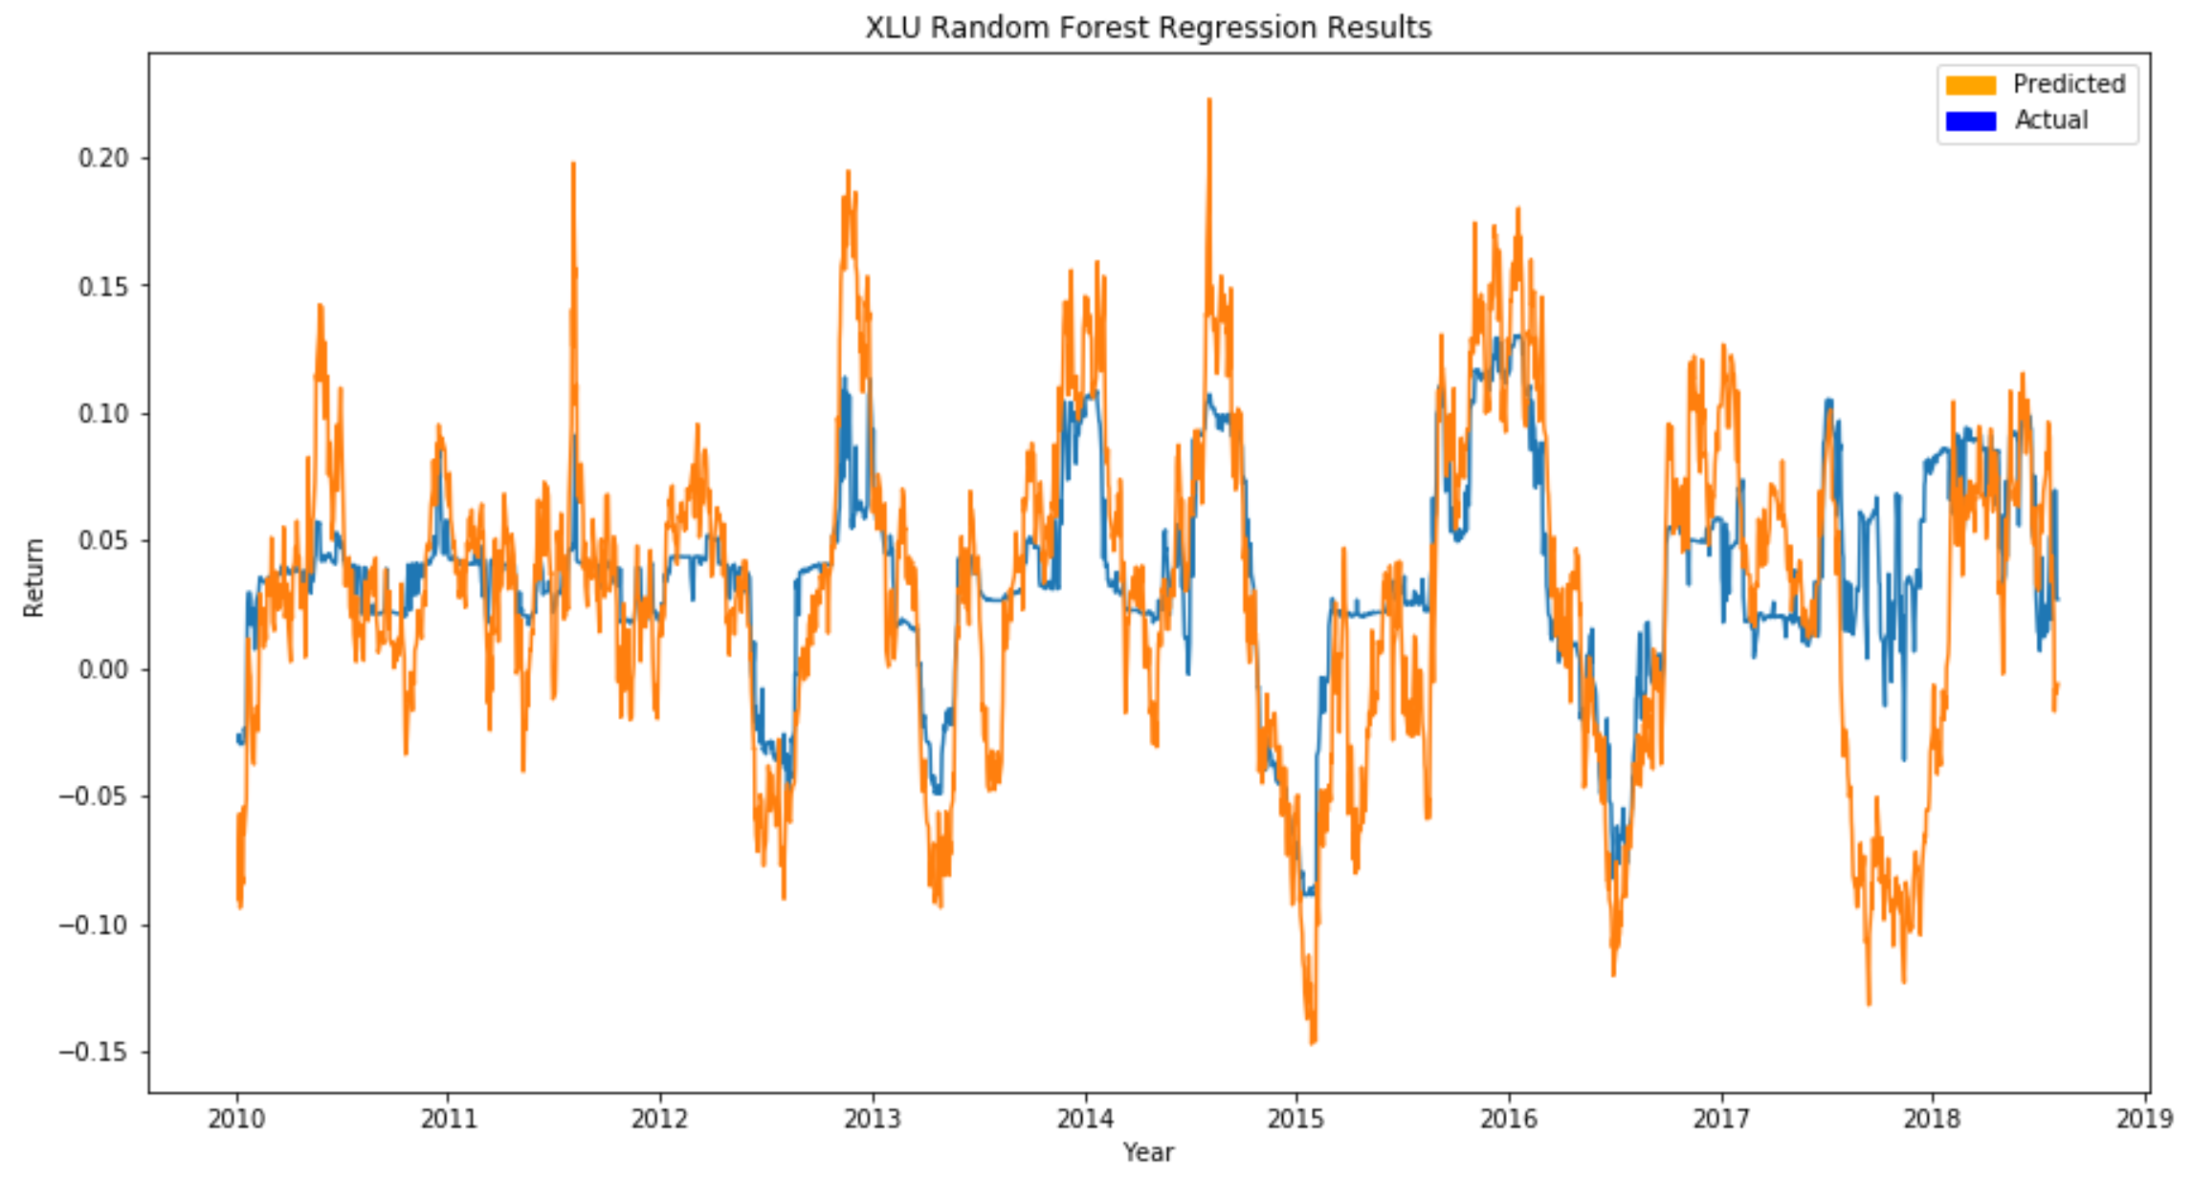
MACHINE LEARNING MODELS FOR ETF PRICE PREDICTION
Random Forest Regression Result for XLU ETF

Slide 20
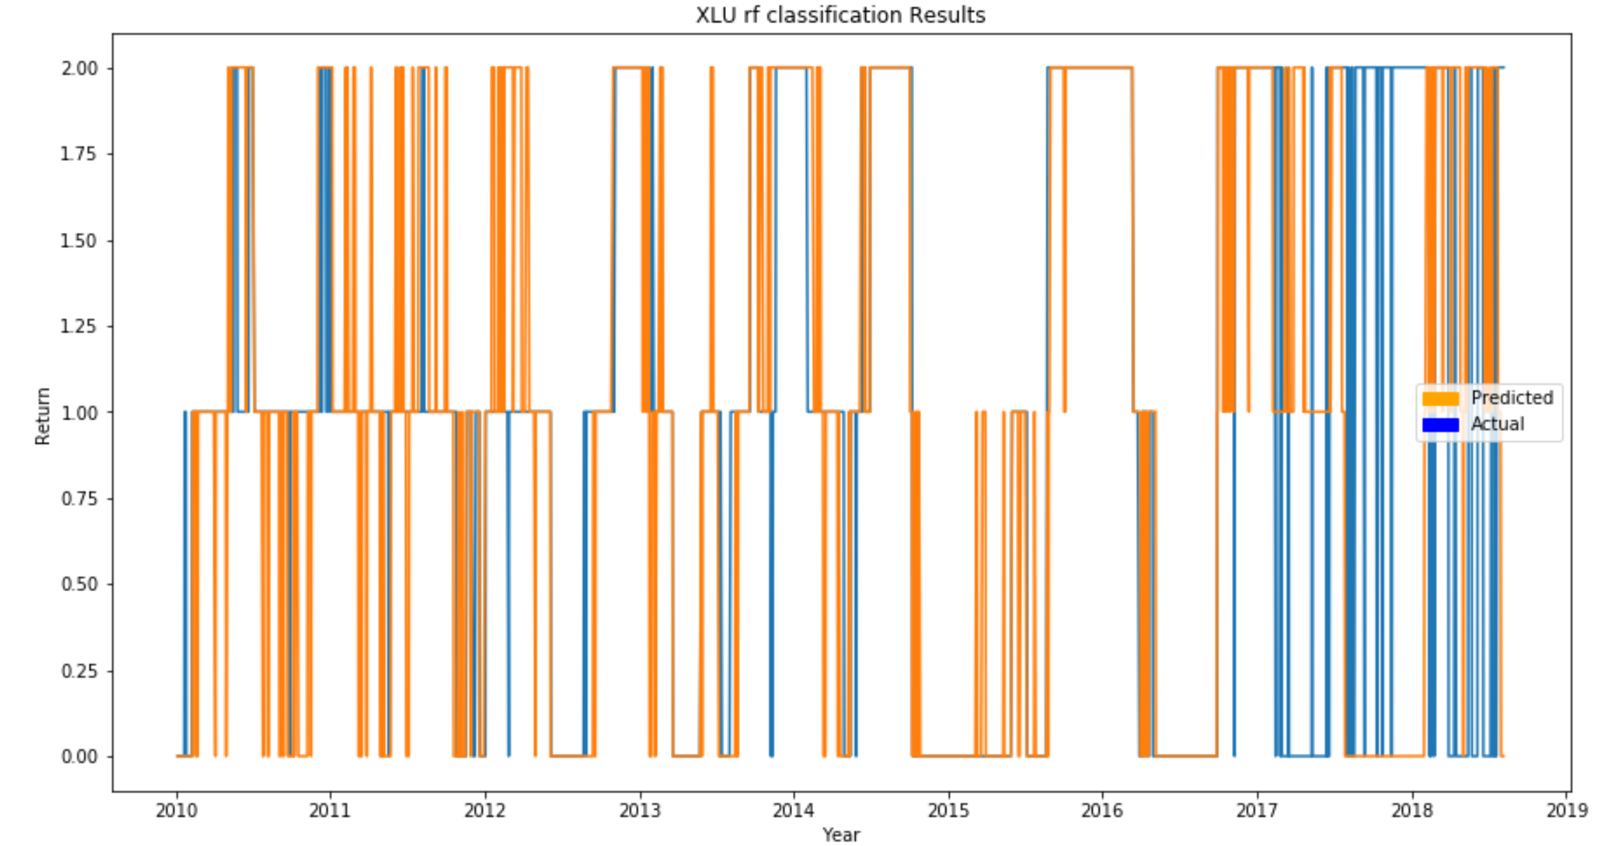
MACHINE LEARNING MODELS FOR ETF RETURN PREDICTION
Random Forest Classification Result for XLU ETF
Notes:
1. Random forest classification had one of the highest mean errors

Slide 21
MACHINE LEARNING MODELS FOR ETF PRICE PREDICTION
Support Vector Machine Model Results
Support Vector Machine Regression
 | error | testr2 | trainr2
FXU | 0.0052 | -0.270 | 0.305
GDX | 0.0507 | -8.610 | 0.465
KBE | 0.0094 | -0.087 | 0.686
RXI | 0.0042 | -0.008 | 0.608
VNQ | 0.0075 | -0.784 | 0.555
XLP | 0.0052 | -0.374 | 0.039
XRT | 0.0108 | -0.179 | 0.864
DIA | 0.0039 | -0.116 | 0.197
IHI | 0.0038 | -0.220 | 0.588
IYW | 0.0059 | -0.030 | 0.492
SHY | 0.0001 | -2.140 | -0.159
VIS | 0.0072 | -0.723 | 0.696
XLE | 0.0148 | -0.498 | 0.665
XLF | 0.0060 | -0.001 | 0.570
XLK | 0.0052 | -0.047 | 0.411
XLU | 0.0048 | -0.066 | 0.390
XLV | 0.0031 | -0.098 | 0.401
XLY | 0.0043 | 0.069 | 0.461
SIL | 0.0180 | -6.932 | -0.067
Support Vector Classification
 | error | test accuracy | testr2 | train accuracy | trainr2
FXU | 1.4214 | 0.364 | -1.155 | 0.8103 | 0.676
GDX | 1.1122 | 0.254 | -2.097 | 0.7047 | 0.264
KBE | 1.0125 | 0.444 | -0.915 | 0.6070 | -0.167
RXI | 1.2818 | 0.227 | -2.260 | 0.4719 | -0.760
VNQ | 0.8928 | 0.534 | -0.709 | 0.5065 | 0.006
XLP | 2.4638 | 0.182 | -3.067 | 0.7649 | 0.548
XRT | 1.1147 | 0.282 | -0.641 | 0.5520 | -0.359
DIA | 1.7855 | 0.269 | -1.907 | 0.4242 | -0.991
IHI | 1.8105 | 0.162 | -2.936 | 0.4060 | -1.143
IYW | 2.0574 | 0.185 | -2.769 | 0.4009 | -1.154
SHY | 2.9426 | 0.107 | -5.415 | 0.5757 | -0.538
VIS | 1.0100 | 0.289 | -1.571 | 0.4554 | -0.819
XLE | 1.3466 | 0.372 | -1.269 | 0.8904 | 0.832
XLF | 0.6010 | 0.399 | 0.000 | 0.7325 | 0.267
XLK | 1.9701 | 0.227 | -2.442 | 0.4804 | -0.633
XLU | 1.6708 | 0.287 | -1.356 | 0.4645 | -0.288
XLV | 0.5686 | 0.461 | 0.069 | 0.8035 | 0.582
XLY | 1.4414 | 0.322 | -1.522 | 0.4685 | -0.696
SIL | 0.1341 | 0.866 | -0.155 | 0.7799 | 0.536

Slide 22
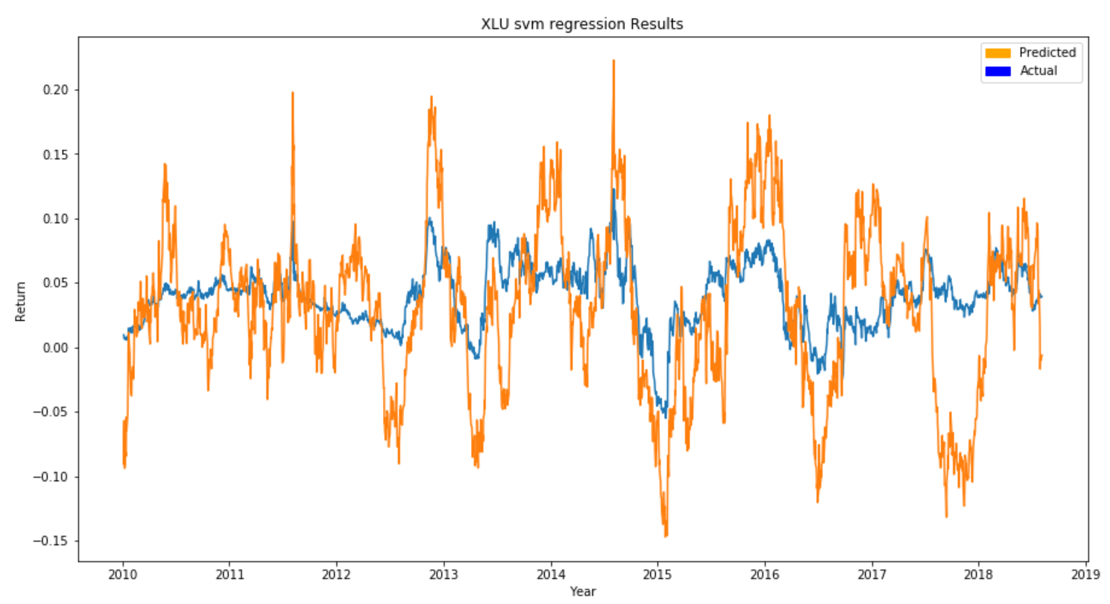
MACHINE LEARNING MODELS FOR ETF RETURN PREDICTION
Support Vector Machine Regression Result for XLU ETF

Slide 23
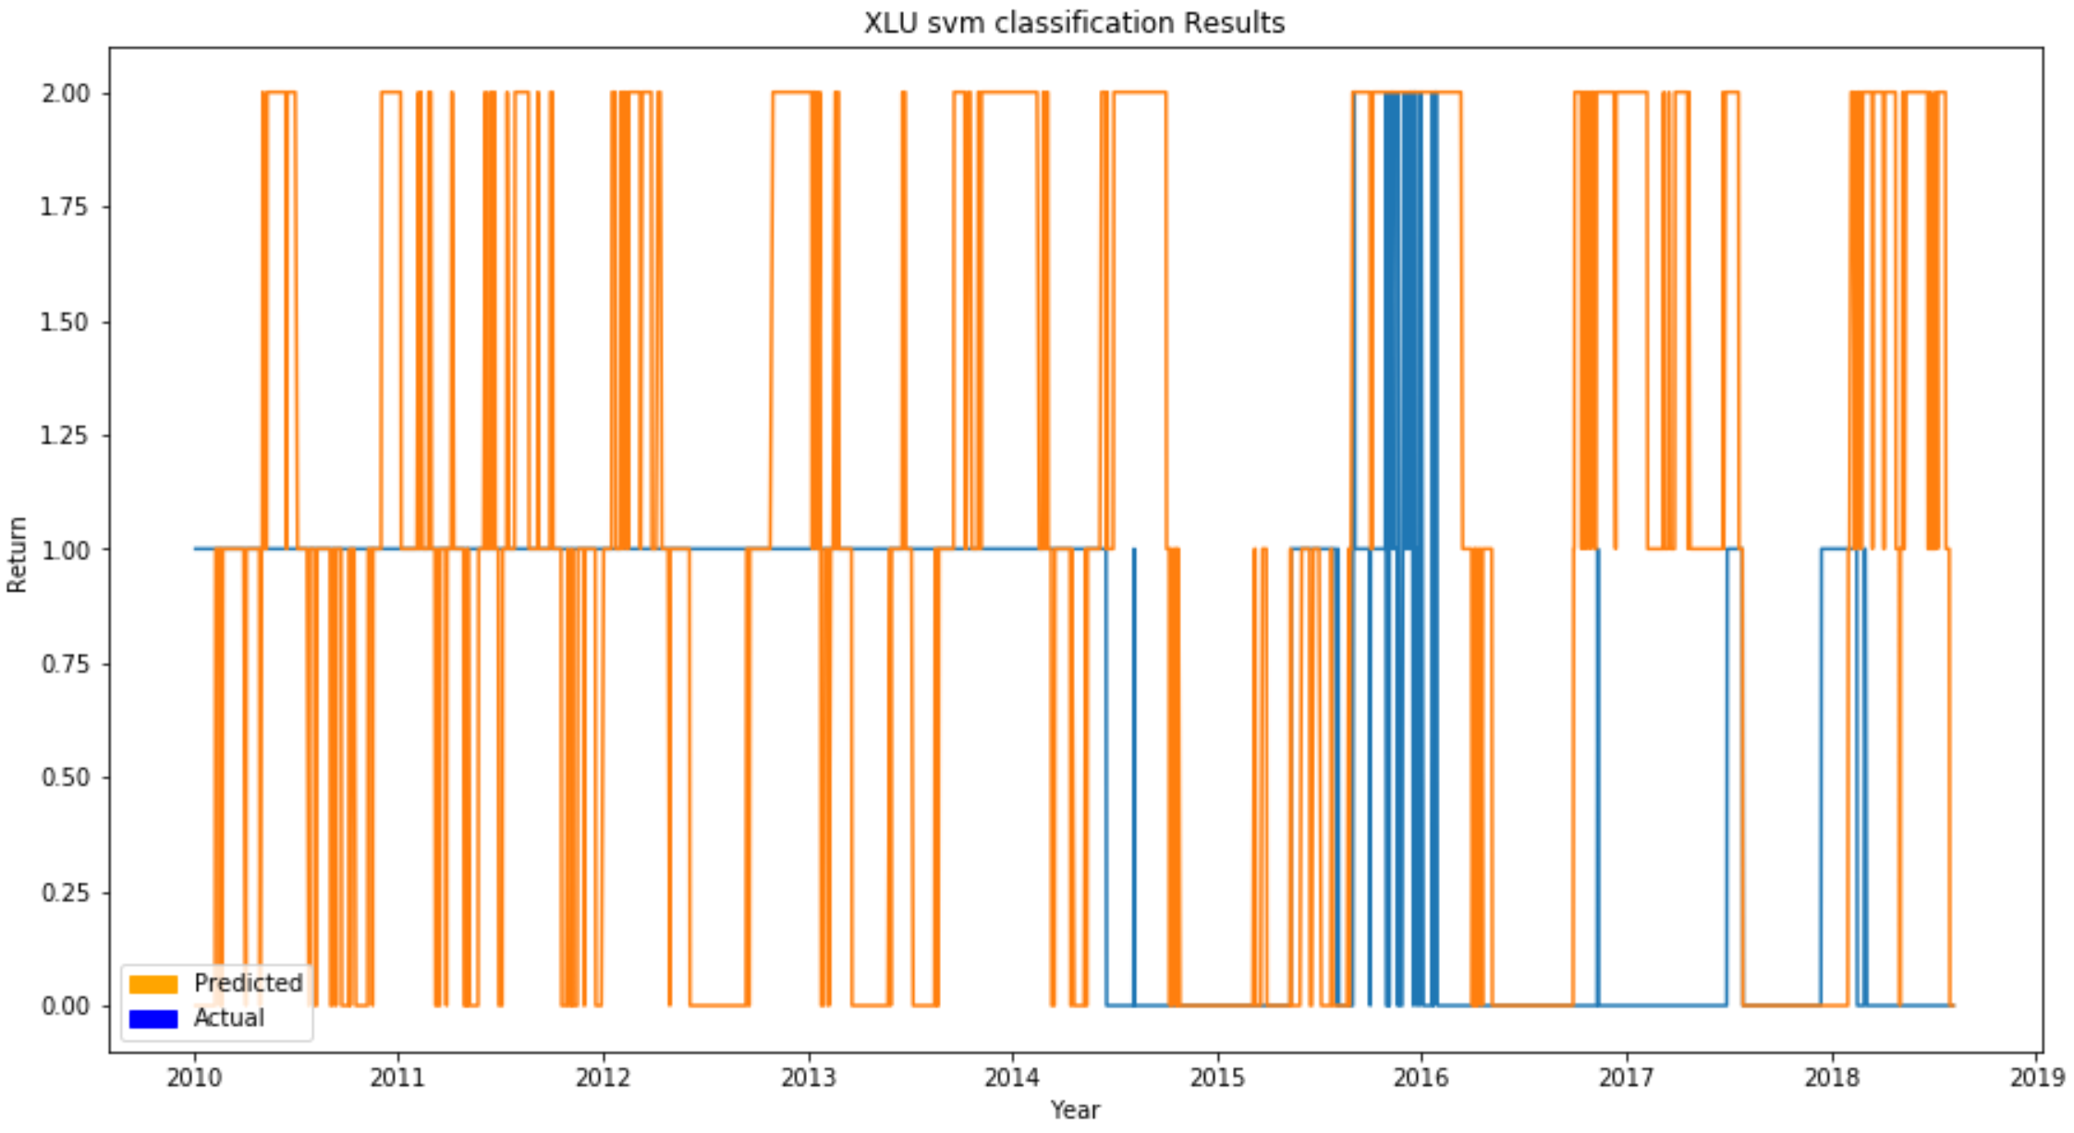
MACHINE LEARNING MODELS FOR ETF RETURN PREDICTION
Support Vector Machine Classification Result for XLU ETF
Notes:
1. SVM classification also had one of the highest mean error

Slide 24
MACHINE LEARNING MODELS FOR ETF PRICE PREDICTION
Gradient Boosting Model Results
Gradient Boosting Machine Regression
 | error | testr2 | trainr2
FXU | 0.0089 | -1.185 | 1.000
GDX | 0.0329 | -5.238 | 0.992
KBE | 0.0130 | -0.502 | 0.475
RXI | 0.0047 | -0.123 | 0.997
VNQ | 0.0105 | -1.514 | 0.817
XLP | 0.0071 | -0.856 | 0.929
XRT | 0.0147 | -0.611 | 1.000
DIA | 0.0029 | 0.161 | 0.697
IHI | 0.0030 | 0.027 | 0.805
IYW | 0.0071 | -0.231 | 0.937
SHY | 0.0001 | -5.286 | 0.675
VIS | 0.0042 | -0.018 | 0.999
XLE | 0.0249 | -1.526 | 0.960
XLF | 0.0052 | 0.126 | 0.997
XLK | 0.0053 | -0.062 | 0.647
XLU | 0.0067 | -0.496 | 0.932
XLV | 0.0093 | -2.281 | 0.700
XLY | 0.0044 | 0.036 | 0.730
SIL | 0.0049 | -1.143 | 0.843
Gradient Boosting Classification
 | error | test accuracy | testr2 | train accuracy | trainr2
FXU | 0.9202 | 0.274 | -0.395 | 1.0000 | 1.000
GDX | 0.9476 | 0.374 | -1.639 | 1.0000 | 1.000
KBE | 1.0723 | 0.436 | -1.028 | 1.0000 | 1.000
RXI | 0.5212 | 0.584 | -0.325 | 1.0000 | 1.000
VNQ | 1.1771 | 0.474 | -1.253 | 1.0000 | 1.000
XLP | 2.1172 | 0.259 | -2.495 | 0.9489 | 0.918
XRT | 1.2319 | 0.367 | -0.813 | 1.0000 | 1.000
DIA | 0.5985 | 0.454 | 0.026 | 0.9466 | 0.918
IHI | 0.9776 | 0.419 | -1.125 | 1.0000 | 1.000
IYW | 0.6733 | 0.416 | -0.233 | 1.0000 | 1.000
SHY | 2.8529 | 0.122 | -5.220 | 0.9608 | 0.929
VIS | 0.4763 | 0.524 | -0.213 | 1.0000 | 1.000
XLE | 1.3466 | 0.372 | -1.269 | 0.9790 | 0.967
XLF | 0.6035 | 0.397 | -0.005 | 1.0000 | 1.000
XLK | 0.6983 | 0.504 | -0.220 | 1.0000 | 1.000
XLU | 2.1072 | 0.254 | -1.971 | 1.0000 | 1.000
XLV | 1.7955 | 0.229 | -1.941 | 0.9529 | 0.925
XLY | 1.3840 | 0.349 | -1.422 | 1.0000 | 1.000
SIL | 0.0732 | 0.927 | 0.370 | 0.9692 | 0.953

Slide 25
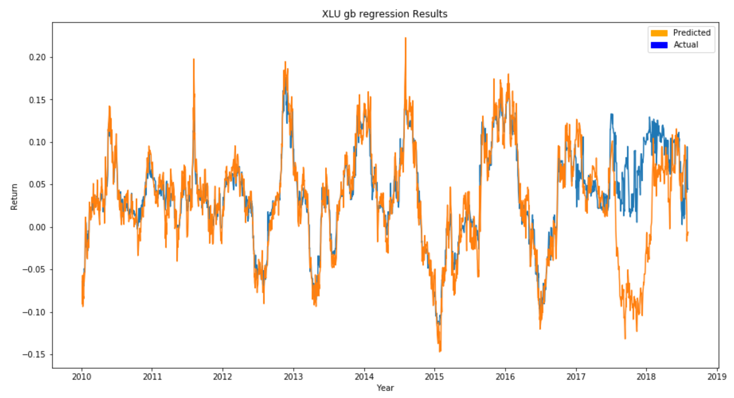
MACHINE LEARNING MODELS FOR ETF RETURN PREDICTION
Gradient Boosting Regression Result for XLU ETF
Notes:
1. Models were overfitting on the training data for every algorithm however Gradient boosting was overfit the most
you can clearly see here from 2010 to 2017 the predicted almost exactly follows the actual values and then the model is quite inaccurate midway through 2017 and onwards which is exactly our testing set

Slide 26
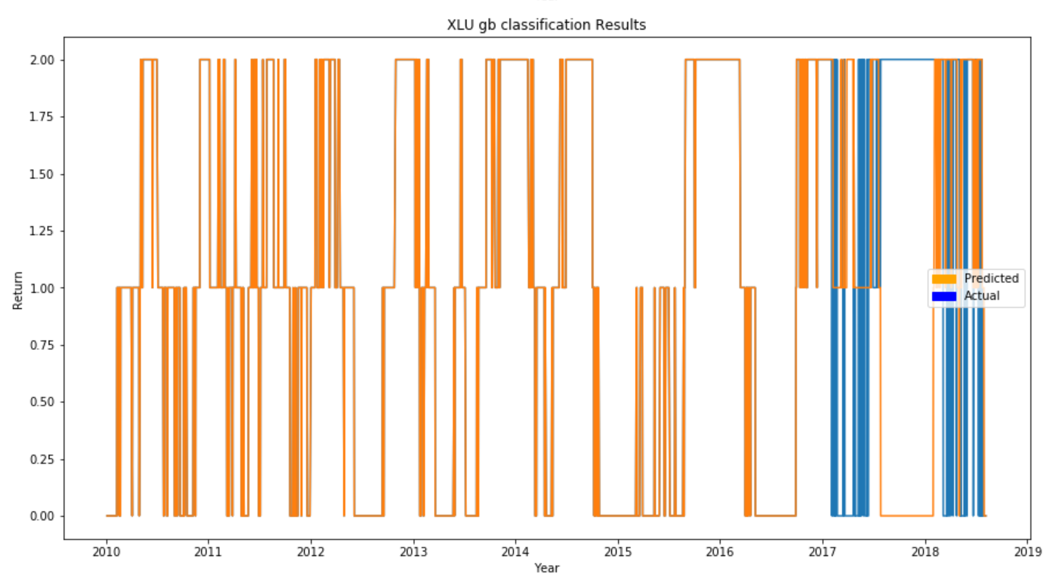
MACHINE LEARNING MODELS FOR ETF RETURN PREDICTION
Gradient Boosting Classification Result for XLU ETF
Notes:
Again, you can see these same trends in the classification graph.
It had 100% accuracy for some ETFs

Slide 27
MACHINE LEARNING MODELS FOR ETF PRICE PREDICTION
Summary of ML Model Results
Summary of Results
 | mean error | mean test r2 | mean train r2 | mean test accuracy | mean train accuracy
Random Forest Regression | 0.0079 | -0.657 | 0.758
Random Forest Classification | 1.2209 | -1.330 | 0.646 | 0.371 | 0.808
Support Vector Machine Regression | 0.0089 | -1.111 | 0.430
Support Vector Machine Classification | 1.4020 | -1.690 | -0.202 | 0.328 | 0.595
Gradient Boosting Regression | 0.0089 | -1.091 | 0.849
Gradient Boosting Classification | 1.1355 | -1.114 | 0.979 | 0.407 | 0.987
1) Models were overfitting on the training data for every algorithm
Gradient Boosting overfit the most
100% accuracy for some ETFs
2) Random Forest Regression had the lowest mean error and the highest mean test r2
SVM classification and RF classification had the highest mean error
2) All models had negative mean test r2 scores
The models performed worse than just using the average on the test data
SVM classification was the worst performing algorithm overall

Slide 28
Random Forest Regression
Baseline Model: Rotational Momentum With
No Prediction Components

Slide 29
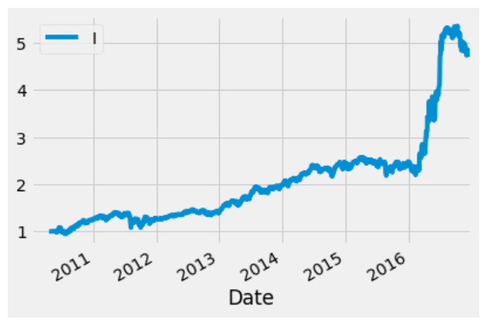
Results – Baseline Model (No Prediction)
Best (Top Total Annual Return) Optimized Returns on Training Data
Parameter | Result
TotaAnnReturn | 52.80
CAGR | 23.80
Sharpe Ratio | 1.19
Standard Deviation | 21.37
Hyperparameter Combinations
Aperiods | 30
Bperiods | 30
Speriods | 5
Frequency | 20W-THU

Slide 30
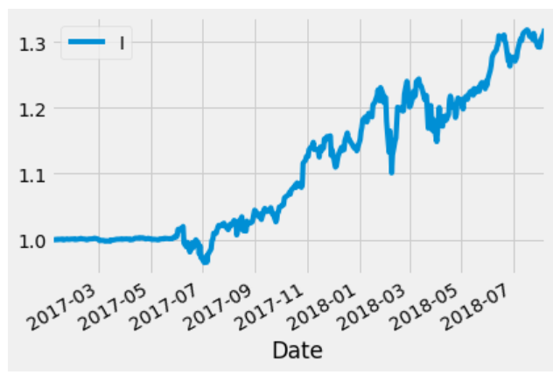
Results – Baseline Model (No Prediction)
Equity Curve for Top Test Set Parameters
Parameter | Result
TotaAnnReturn | 19.87
CAGR | 18.25
Sharpe Ratio | 1.40
Standard Deviation | 13.13
Hyperparameter Combinations
Aperiods | 50
Bperiods | 50
Speriods | 5
Frequency | 20W-THU

Slide 31
Random Forest Regression
Rotational Momentum With
Random Forest Regression Predictions

Slide 32
RESULTS - Random Forest Regression Prediction
Top 10 Annual Return Combinations from Training Data
TotaAnnReturn | CAGR | Sharpe Ratio | Aperiods | Bperiods | Speriods
80.46598 | 29.82 | 1.28 | 50 | 50 | 1
73.91489 | 28.55 | 1.49 | 10 | 10 | 20
71.17508 | 28 | 1.48 | 10 | 50 | 25
71.17508 | 28 | 1.48 | 50 | 10 | 25
69.36205 | 27.62 | 1.52 | 10 | 40 | 35
69.36205 | 27.62 | 1.52 | 40 | 10 | 35
68.64556 | 27.47 | 1.41 | 15 | 20 | 20
68.64556 | 27.47 | 1.41 | 20 | 15 | 20
66.57648 | 27.03 | 1.48 | 10 | 40 | 15
66.57648 | 27.03 | 1.48 | 40 | 10 | 15

Slide 33
Results - Random Forest Regression Prediction
Top 10 Sharpe Ratio Combinations from Training Data
TotaAnnReturn | CAGR | Sharpe Ratio | Aperiods | Bperiods | Speriods
53.99494 | 24.11 | 1.75 | 10 | 20 | 10
53.99494 | 24.11 | 1.75 | 20 | 10 | 10
52.77655 | 23.8 | 1.71 | 10 | 30 | 30
52.77655 | 23.8 | 1.71 | 30 | 10 | 30
52.00436 | 23.6 | 1.71 | 10 | 30 | 10
52.00436 | 23.6 | 1.71 | 30 | 10 | 10
53.16439 | 23.9 | 1.7 | 10 | 30 | 15
53.16439 | 23.9 | 1.7 | 30 | 10 | 15
52.80107 | 23.8 | 1.68 | 10 | 30 | 25
52.80107 | 23.8 | 1.68 | 30 | 10 | 25

Slide 34
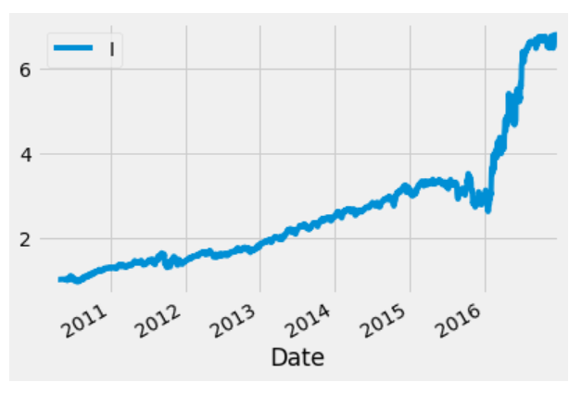
Results - Random Forest Regression Prediction
Best (Top Total Annual Return) Optimized Returns on Training Data
Parameter | Result | Baseline - Results
TotaAnnReturn | 80.47 | 52.80
CAGR | 29.82 | 23.80
Sharpe Ratio | 1.28 | 1.19
Standard Deviation | 24.59 | 21.37
Hyperparameter Combinations
Aperiods | 50
Bperiods | 50
Speriods | 1
Frequency | 20W-THU

Slide 35
Results - Random Forest Regression Prediction
Top 10 Total Annual Return Results on Test Data from Top Performing Training Set Combinations
TotaAnnReturn | CAGR | Sharpe Ratio | Aperiods | Bperiods | Speriods
20.82828 | 19.08 | 1.49 | 10 | 50 | 25
20.82828 | 19.08 | 1.49 | 50 | 10 | 25
19.08927 | 17.56 | 1.37 | 15 | 20 | 20
19.08927 | 17.56 | 1.37 | 20 | 15 | 20
18.99102 | 17.48 | 1.2 | 10 | 40 | 5
18.99102 | 17.48 | 1.2 | 40 | 10 | 5
18.99102 | 17.48 | 1.2 | 10 | 50 | 5
18.99102 | 17.48 | 1.2 | 50 | 10 | 5
18.77268 | 17.29 | 1.32 | 50 | 50 | 1
18.77268 | 17.29 | 1.32 | 40 | 50 | 1

Slide 36
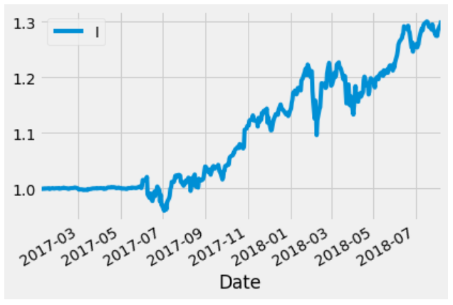
Results - Random Forest Regression Prediction
Equity Curve for Top Test Set Parameters
Parameter | Result | Baseline - Results
TotaAnnReturn | 18.77 | 19.87
CAGR | 17.29 | 18.25
Sharpe Ratio | 1.32 | 1.40
Standard Deviation | 13.27 | 13.13
Hyperparameter Combinations
Aperiods | 50
Bperiods | 50
Speriods | 1
Frequency | 20W-THU

Slide 37
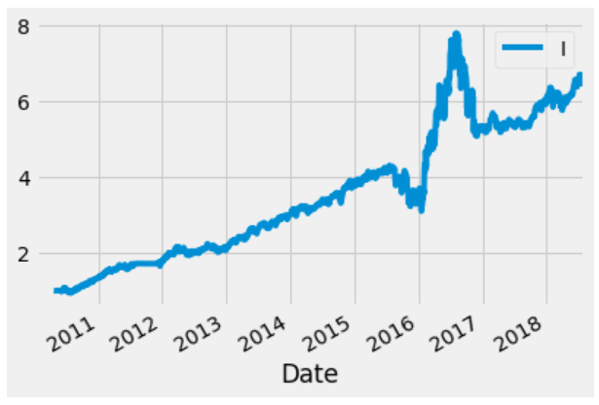
Results - Random Forest Regression Prediction
Equity Curve for Full Dataset (2010-2019) Using Best Training and Test Set Parameters
Parameter | Result
TotaAnnReturn | 64.13
CAGR | 23.42
Sharpe Ratio | 1.08
Standard Deviation | 23.65
Hyperparameter Combinations
Aperiods | 50
Bperiods | 50
Speriods | 1
Frequency | 20W-THU

Slide 38
Random Forest Regression
Rotational Momentum With
Support Vector Machine Regression Predictions

Slide 39
Results – Support Vector Machine Regression Prediction
Top 10 Annual Return Combinations from Training Data
TotaAnnReturn | CAGR | Sharpe Ratio | Aperiods | Bperiods | Speriods
78.10348 | 29.37 | 1.26 | 40 | 40 | 1
75.56381 | 28.88 | 1.24 | 15 | 40 | 1
75.56381 | 28.88 | 1.24 | 40 | 15 | 1
72.18962 | 28.2 | 1.22 | 20 | 40 | 1
72.18962 | 28.2 | 1.22 | 40 | 20 | 1
70.84475 | 27.93 | 1.21 | 30 | 40 | 1
70.84475 | 27.93 | 1.21 | 40 | 30 | 1
70.36787 | 27.83 | 1.2 | 15 | 20 | 5
70.36787 | 27.83 | 1.2 | 20 | 15 | 5
69.43429 | 27.63 | 1.22 | 15 | 30 | 5

Slide 40
Results – Support Vector Machine Regression Prediction
Top 10 Sharpe Ratio Combinations from Training Data
TotaAnnReturn | CAGR | Sharpe Ratio | Aperiods | Bperiods | Speriods
52.38494 | 23.7 | 1.61 | 10 | 10 | 25
51.16588 | 23.39 | 1.55 | 10 | 40 | 35
51.16588 | 23.39 | 1.55 | 40 | 10 | 35
47.7654 | 22.48 | 1.55 | 10 | 10 | 30
49.07512 | 22.84 | 1.53 | 10 | 30 | 25
49.07512 | 22.84 | 1.53 | 30 | 10 | 25
47.38738 | 22.38 | 1.52 | 10 | 10 | 35
49.2512 | 22.88 | 1.51 | 10 | 40 | 30
49.2512 | 22.88 | 1.51 | 40 | 10 | 30
51.58518 | 23.49 | 1.5 | 10 | 15 | 30

Slide 41
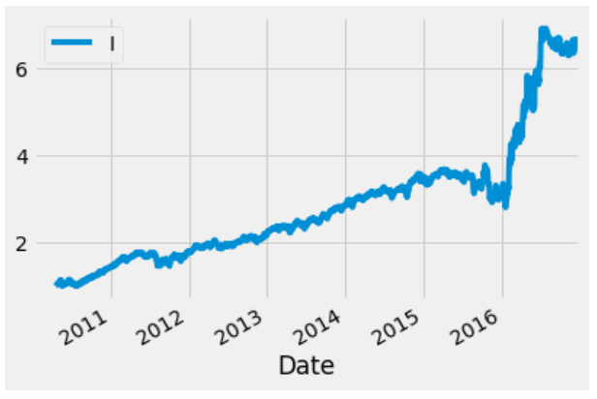
Results – Support Vector Machine Regression Prediction
Best (Top Total Annual Return) Optimized Returns on Training Data
Parameter | Result | Baseline – Results
TotaAnnReturn | 78.10 | 52.80
CAGR | 29.37 | 23.80
Sharpe Ratio | 1.26 | 1.19
Standard Deviation | 24.71 | 21.37
Hyperparameter Combinations
Aperiods | 40
Bperiods | 40
Speriods | 1
Frequency | 20W-THU

Slide 42
Results – Support Vector Machine Regression Prediction
Top 10 Total Annual Return Results on Test Data from Top Performing Training Set Combinations
TotaAnnReturn | CAGR | Sharpe Ratio | Aperiods | Bperiods | Speriods
27.95611 | 25.16 | 1.62 | 15 | 20 | 5
27.95611 | 25.16 | 1.62 | 20 | 15 | 5
26.702 | 24.1 | 1.63 | 15 | 40 | 1
26.702 | 24.1 | 1.63 | 40 | 15 | 1
25.96767 | 23.48 | 1.51 | 15 | 30 | 5
25.96767 | 23.48 | 1.51 | 30 | 15 | 5
25.96767 | 23.48 | 1.51 | 15 | 40 | 5
25.96767 | 23.48 | 1.51 | 40 | 15 | 5
25.96767 | 23.48 | 1.51 | 10 | 15 | 5
25.96767 | 23.48 | 1.51 | 15 | 10 | 5

Slide 43
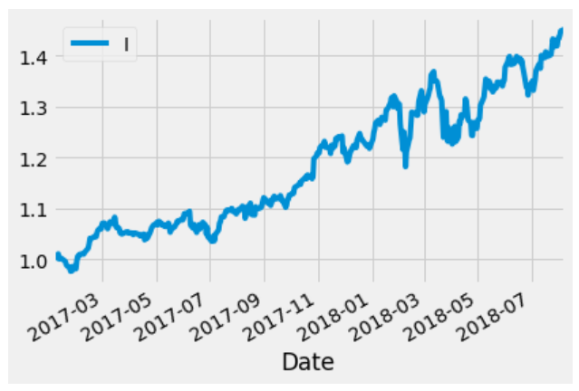
Results – Support Vector Machine Regression Prediction
Best (Top Total Annual Return) Optimized Returns on Training Data
Parameter | Result | Baseline – Results
TotaAnnReturn | 27.96 | 19.87
CAGR | 25.16 | 18.25
Sharpe Ratio | 1.62 | 1.40
Standard Deviation | 15.16 | 13.13
Hyperparameter Combinations
Aperiods | 15
Bperiods | 20
Speriods | 5
Frequency | 20W-THU

Slide 44
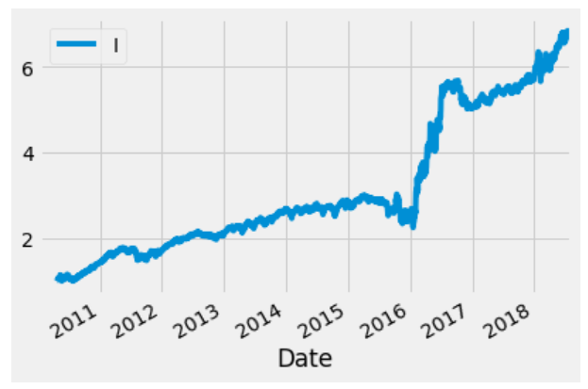
Results – Support Vector Machine Regression Prediction
Equity Curve for Full Dataset (2010-2019) Using Best Training and Test Set Parameters
Parameter | Result
TotaAnnReturn | 67.20
CAGR | 23.97
Sharpe Ratio | 1.15
Standard Deviation | 22.29
Hyperparameter Combinations
Aperiods | 15
Bperiods | 20
Speriods | 5
Frequency | 20W-THU

Slide 45
Random Forest Regression
Rotational Momentum With
Random Forest Classification Predictions

Slide 46
Results – Random Forest Classification Prediction
Top 10 Annual Return Combinations from Training Data
TotaAnnReturn | CAGR | Sharpe Ratio | Aperiods | Bperiods | Speriods
32.6432 | 17.86 | 0.76 | 15 | 40 | 1
32.6432 | 17.86 | 0.76 | 40 | 15 | 1
30.58837 | 17.14 | 0.74 | 15 | 30 | 1
30.58837 | 17.14 | 0.74 | 30 | 15 | 1
28.85201 | 16.5 | 0.72 | 15 | 50 | 1
28.85201 | 16.5 | 0.72 | 50 | 15 | 1
27.89963 | 16.15 | 0.71 | 40 | 40 | 1
27.27125 | 15.91 | 0.69 | 15 | 15 | 1
27.02324 | 15.81 | 0.68 | 50 | 50 | 1
26.94259 | 15.78 | 0.7 | 30 | 40 | 1

Slide 47
Results – Random Forest Classification Prediction
Top 10 Sharpe Ratio Combinations from Training Data
TotaAnnReturn | CAGR | Sharpe Ratio | Aperiods | Bperiods | Speriods
26.65525 | 15.67 | 1.25 | 10 | 10 | 5
26.7067 | 15.69 | 1.02 | 20 | 40 | 35
26.7067 | 15.69 | 1.02 | 40 | 20 | 35
24.99106 | 15.01 | 1.02 | 15 | 15 | 25
23.80616 | 14.52 | 1 | 15 | 15 | 35
23.73813 | 14.5 | 0.99 | 15 | 15 | 20
20.42542 | 13.07 | 0.99 | 10 | 10 | 25
24.28961 | 14.72 | 0.86 | 15 | 30 | 25
24.28961 | 14.72 | 0.86 | 30 | 15 | 25
21.46603 | 13.53 | 0.83 | 10 | 30 | 5

Slide 48
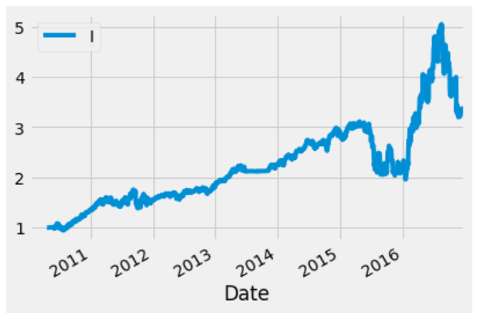
Results – Random Forest Classification Prediction
Best (Top Total Annual Return) Optimized Returns on Training Data
Parameter | Result | Baseline – Results
TotaAnnReturn | 32.64 | 52.80
CAGR | 17.86 | 23.80
Sharpe Ratio | 0.76 | 1.19
Standard Deviation | 29.03 | 21.37
Hyperparameter Combinations
Aperiods | 15
Bperiods | 40
Speriods | 1
Frequency | 20W-THU

Slide 49
Results – Random Forest Classification Prediction
Top 10 Total Annual Return Results on Test Data from Top Performing Training Set Combinations
TotaAnnReturn | CAGR | Sharpe Ratio | Aperiods | Bperiods | Speriods
18.03868 | 16.64 | 1.57 | 15 | 30 | 20
18.03868 | 16.64 | 1.57 | 30 | 15 | 20
16.63741 | 15.41 | 1.28 | 15 | 40 | 25
16.63741 | 15.41 | 1.28 | 40 | 15 | 25
14.48361 | 13.49 | 1.32 | 30 | 30 | 1
14.48302 | 13.49 | 1.15 | 15 | 15 | 25
14.48302 | 13.49 | 1.15 | 15 | 15 | 20
14.07386 | 13.13 | 1.16 | 15 | 15 | 35
13.89622 | 12.97 | 1.21 | 15 | 30 | 35
13.89622 | 12.97 | 1.21 | 30 | 15 | 35

Slide 50
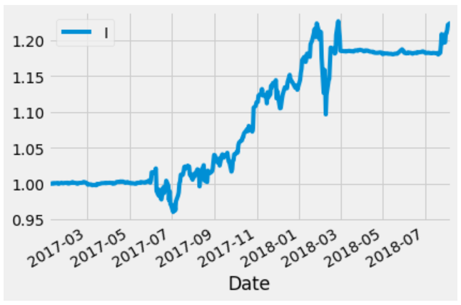
Results – Random Forest Classification Prediction
Best (Top Total Annual Return) Optimized Returns on Training Data
Parameter | Result | Baseline – Results
TotaAnnReturn | 13.88 | 19.87
CAGR | 12.95 | 18.25
Sharpe Ratio | 1.21 | 1.40
Standard Deviation | 11.06 | 13.13
Hyperparameter Combinations
Aperiods | 50
Bperiods | 50
Speriods | 1
Frequency | 20W-THU

Slide 51
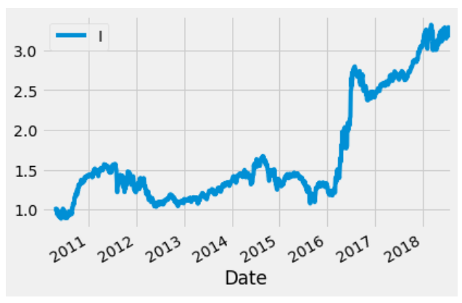
Results – Random Forest Classification Prediction
Equity Curve for Full Dataset (2010-2019) Using Best Training and Test Set Parameters
Parameter | Result
TotaAnnReturn | 26.35
CAGR | 14.24
Sharpe Ratio | 0.75
Standard Deviation | 22.75
Hyperparameter Combinations
Aperiods | 15
Bperiods | 20
Speriods | 5
Frequency | 20W-THU

Slide 52
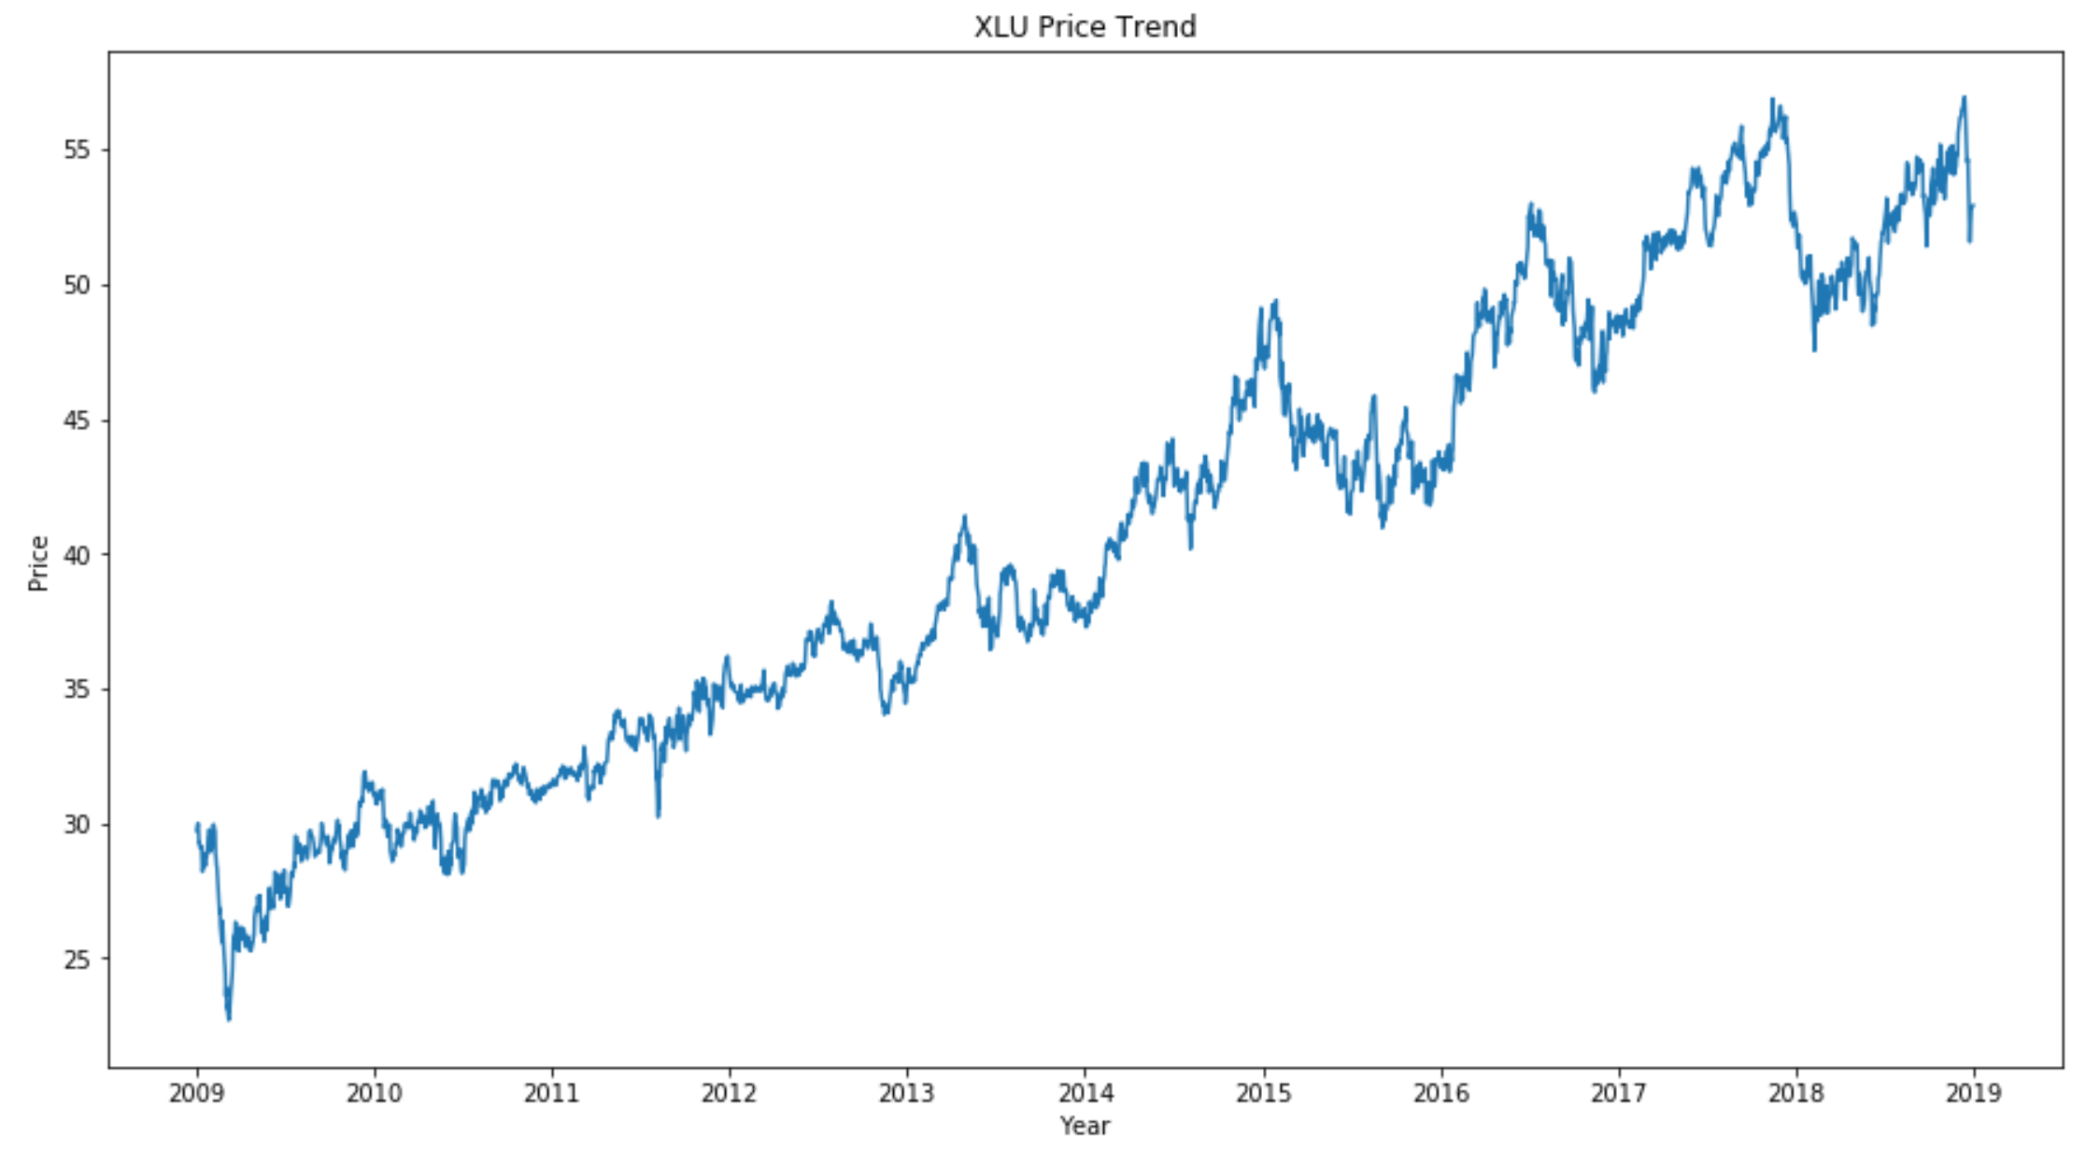
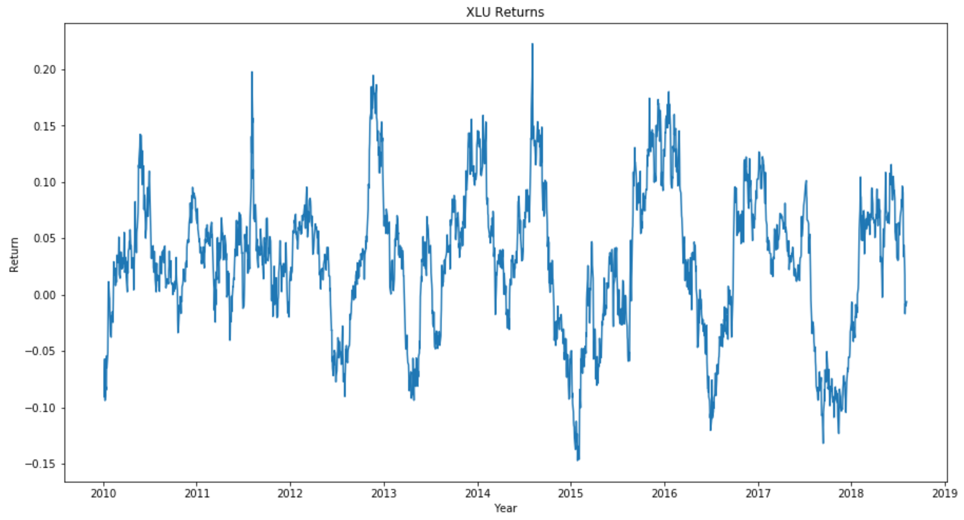
NEXT STEPS
Future Considerations
Recommendation #1
Improve models by transforming the data to a stationary series
Estimate the trend and seasonality in the series and remove those from the series
Convert the forecasted values back to the original scale by applying trend and seasonality constraints
Recommendation #2
Incorporate an LSTM neural network

Slide 53
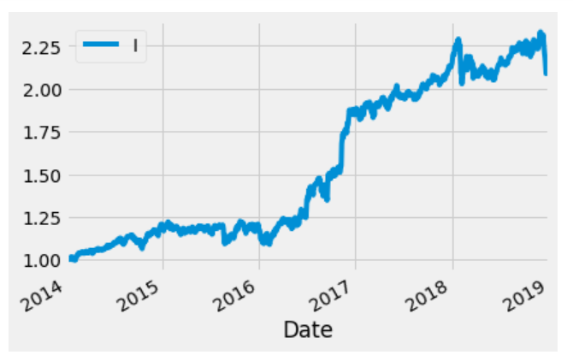
NEXT STEPS
Future Considerations
Incorporate a larger universe of ETFs to diversify the portfolio further. Utilize the clustering program to automatically select ETFs that are similar to one another in terms of volatility for use in the rotational momentum program
Build in a contingency to allow the program to pull out of a long position and move capital to the SHY ETF anytime during the holding period if the current ETF selection falls below 1 STD of its moving average. Period for moving average would need to be optimized.
Roughly Speaking the redlines represent the holding period or the frequency of the re-investment

Slide 54
thanks!
Any questions?

